Slide 1
Bank Churn Predictions
Vikas Kheni
Novemeber 20, 2023

Slide 2
Churn Modelling
Predict if a bank’s customer will stay or leave the bank
Business case:
banking
Objective

Slide 3
Churn Modelling
Kaggle Churn Modelling Dataset
10,000 records
Demographic information
Banking information
Data Source

Slide 4
Churn Modelling
ETL & EDA
Create and save Machine Learning models
Deployment of ML models
How ?

Slide 5
ETL & Exploratory Data Analysis

Slide 6
ETL
Kaggle Dataset → very clean
Removing features not needed for ML:
RowNumber
CustomerId
Surname
Save it as the analytical base table (abt)
abt → input to all modelling notebooks
Extract, Transform, Load

Slide 7
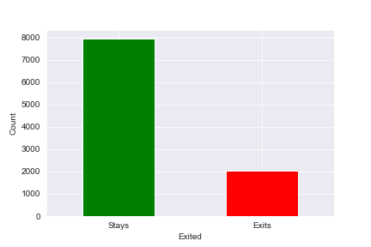
Target Feature Distribution
Imbalanced dataset:
Stays - 79.63%
Exits - 20.37%
Handling imbalanced classes:
SMOTE*
*Synthetic Minority Over-sampling Technique

Slide 8
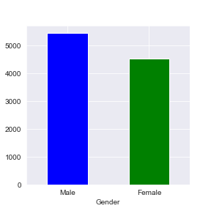
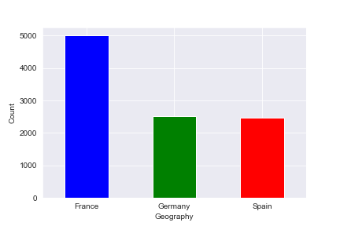
Distributions of Categorical Features
More males than females
France 50%; Spain, Germany 25% each

Slide 9
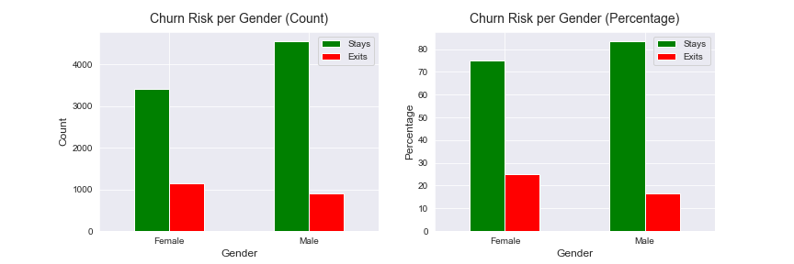
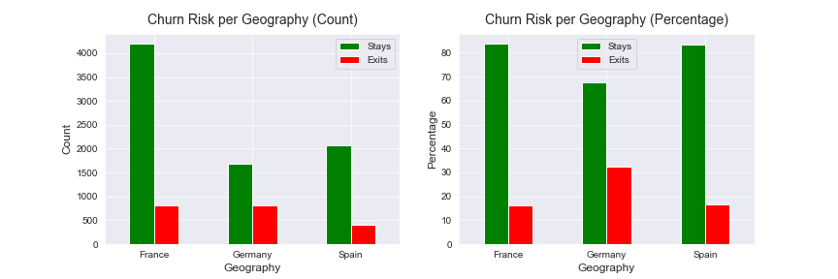
Churn Segmentation by Gender/Geography
Leaving bank:
females 25%
males 16%
1 of 3 German customers
Germany: least customers → most churn

Slide 10
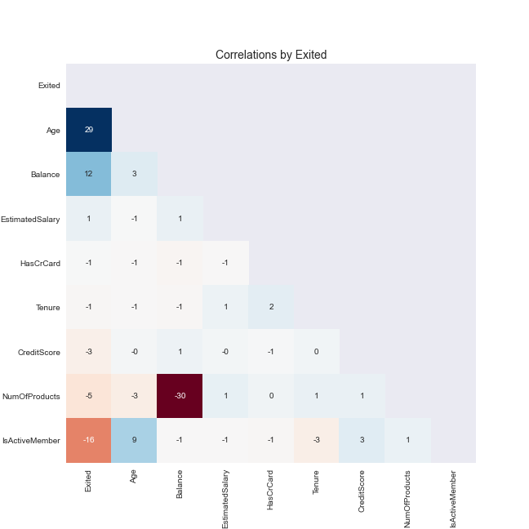
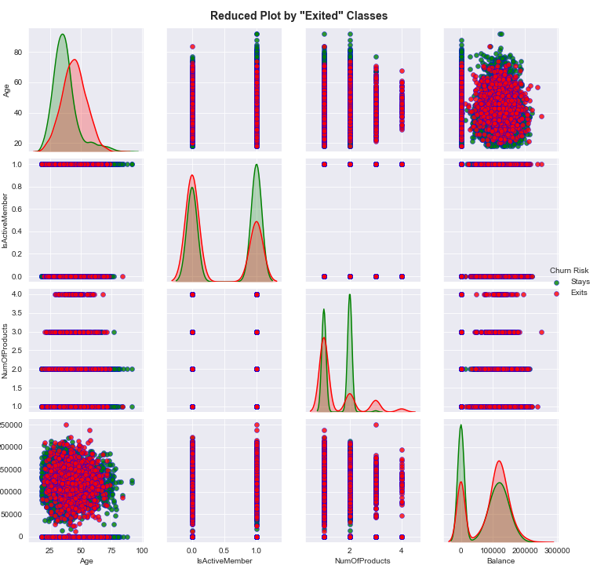
Correlations and Pairplot
Notes:
Very weak correlations in general. Only weak positive correlation with age, very weak positive correlation with balance, and very weak negative correlations with number of products and membership.
The density plots on the diagonal make it easier to compare these distributions. We can notice that only few features have slightly different distributions. For example, from the density plot for Age, it could be seen that older people have slightly higher tendency to leave the bank.

Slide 11
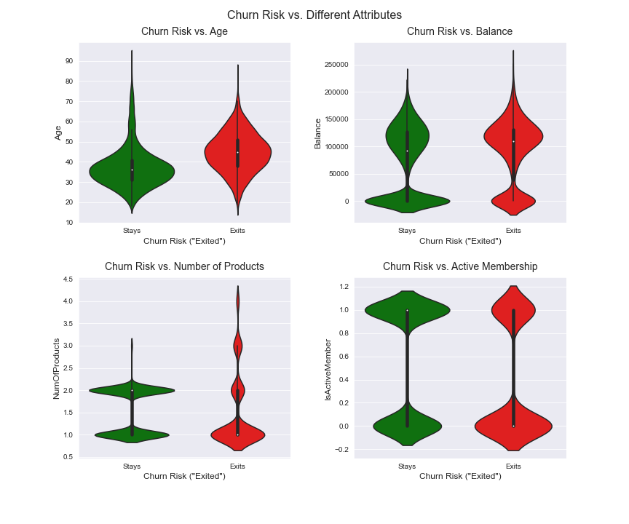
Violin Plots
confirming insights from correlations and pairplot - most likely to leave:
older customers
customers with more products

Slide 12
Machine Learning Modelling

Slide 13
Used Models
Scikit-learn
Decision Tree
K-nearest Neighbor
Logistic Regression
Random Forest
Support Vector machine (SVM)
XGBoost
Deep Learning
Keras (with SciKeras wrapper for Scikit-learn)

Slide 14
Model Training Steps
load abt
features - target variable split
train - test split
preprocessing pipeline
model pipeline
hyperparameters tuning:
parameters grid
GridSearchCV
RandomizedSearchCV*
save best fit model
*Deep Learning only

Slide 15
Pipelines
preprocessing pipeline
preprocess = make_column_transformer(
(MinMaxScaler(),num_features,
(OneHotEncoder(sparse=False), cat_features))
model pipeline
model = imbl_pipe(
preprocess, SMOTE(sampling_strategy='auto', random_state=random_state),
“model_classifier”*)
*replace with a classifier for the used model

Slide 16
Keras Classifier
implement Scikit-learn interface
from scikeras.wrappers import KerasClassifier
import keras_model as km
clf = KerasClassifier(model=km.get_clf,
loss=BinaryCrossentropy,
. . .
verbose=0,
random_state=random_state,
)
keras_model.py
from tf.keras.layers import Dense, Input, Dropout
from tf.keras.models import Sequential
# Defining Keras model creator function
def get_clf(meta, hidden_layer_sizes, dropout):
n_features_in_ = meta["n_features_in_"]
X_shape_ = meta["X_shape_"]
n_classes_ = meta["n_classes_"]
model = Sequential()
model.add(Dense(n_features_in_, activation='relu', input_shape=X_shape_[1:]))
for hidden_layer_size in hidden_layer_sizes:
model.add(Dense(hidden_layer_size, activation="relu"))
model.add(Dropout(dropout))
model.add(Dense(1, activation="sigmoid"))
return model

Slide 17
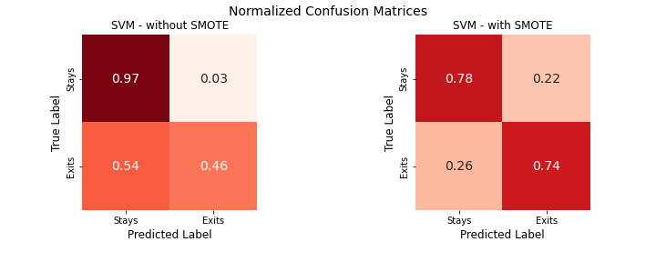
Why SMOTE?
(Synthetic Minority Over-sampling Technique)
better recall results (a goal for customer churning tasks)
TP: 46% → 74%
pretty close TP and TN

Slide 18
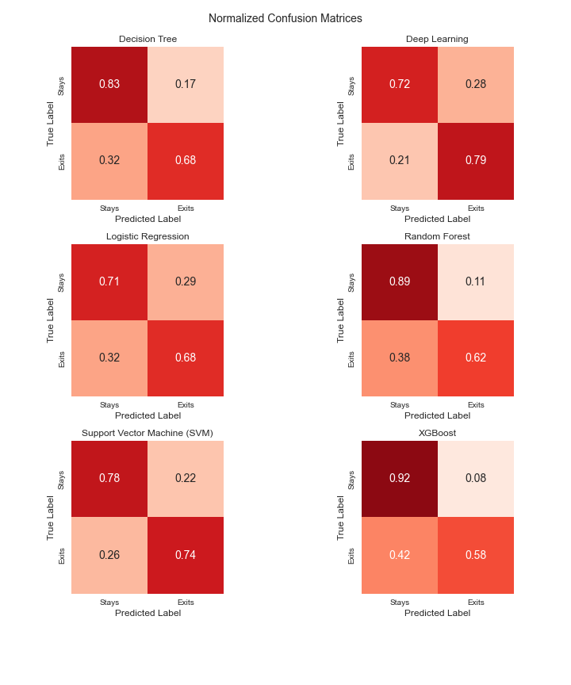
Summary
evaluation:
recall, f1-score
goal:
increase TP, decrease FN
Best models:
Deep learning
SVM

Slide 19
Deployment of ML Models

Slide 20
Flask and HTML - 1
app.py - Flask API
loads models
receives customer details through GUI
computes and returns predictions
returns customer info table
HTML/CSS/Bootstrap
HTML template and CSS styling to enter customer info
jinja - loads data passed by Flask:
predictions
customer info table

Slide 21
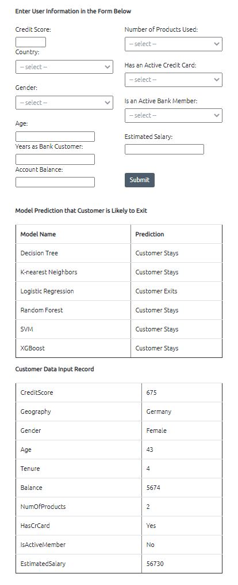
Flask and HTML - 2
app.py
.
.
.
@app.route('/predict', methods=['POST'])
def predict():
.
.
.
return render_template('index.html', maind=maind)
.
.
customer info
predictions
customer table

Slide 22
Live Demo
deployed to Heroku
Heroku build size limit → Deep Learning model replaced with K-nearest neighbor
migrated to Render (Nov 2022)
let’s see it in action: https://bank-churn-predictions.onrender.com/

Slide 23
Conclusions
best models:
Deep Learning
SVM
huge difference with SMOTE
ways for improvement
more data points
feature selection
feature engineering
additional ML algorithms and imbalance handling techniques
finer hyperparameter tuning

Slide 24
Questions?

Slide 25
Contact Info
Damir Zunic
zunicd@yahoo.com
LinkedIn
GitHub
317-614-5312
Kevin Scoleri
kscoleri89@gmail.com
LinkedIn
GitHub
219-629-0807

